Slide 1
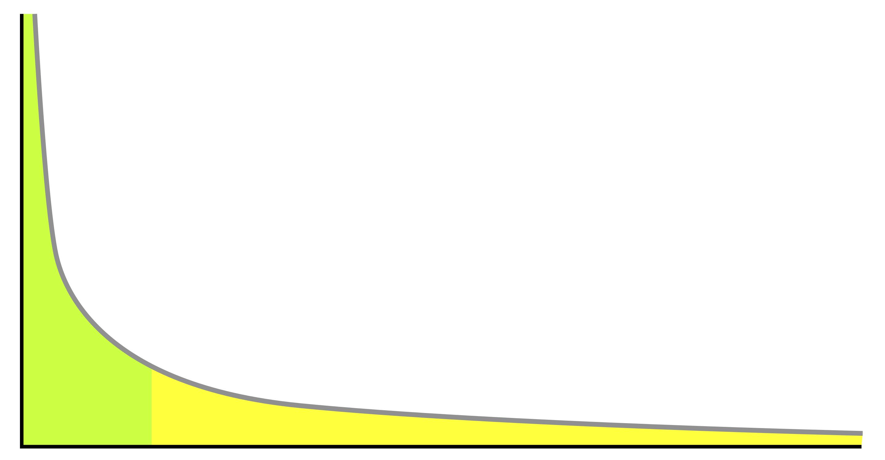
ಅ
🗣
Natural Language Generation and the Perils of Zipfian Distribution
🤔
A
Dissertation Proposal
by
Thamme Gowda
Committee
Jonathan May (chair)
Xuezhe Max
Xiang Ren
Shri
Chris Mattmann
Aiichiro Nakano

Slide 2
Overview
Natural language generation / machine translation
Long-tail: gift or curse ?
Two problems: (1) open-vocabulary (2) data imbalance
Open-vocabulary generation: optimal vocabulary size
Evaluation on imbalanced sets: rare classes are important too
Applications:
Multilingual NMT: 500 languages to English translation

Slide 3
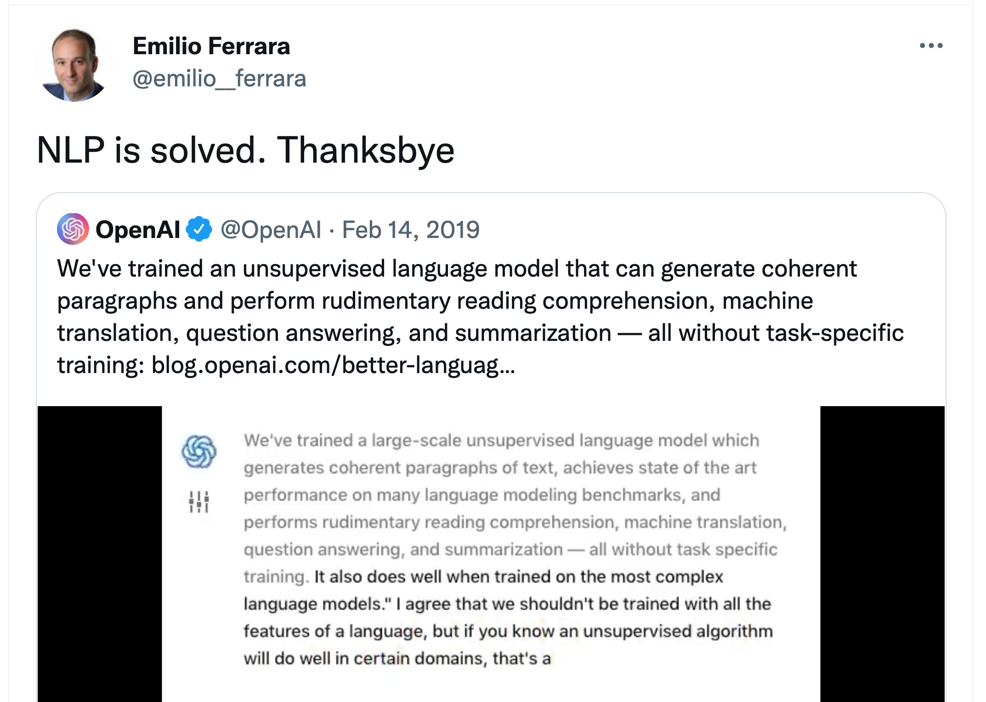
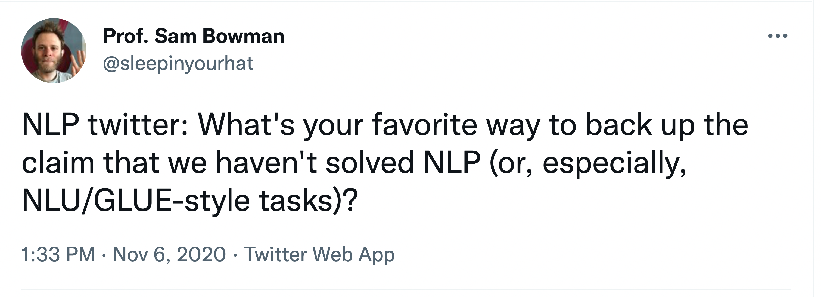
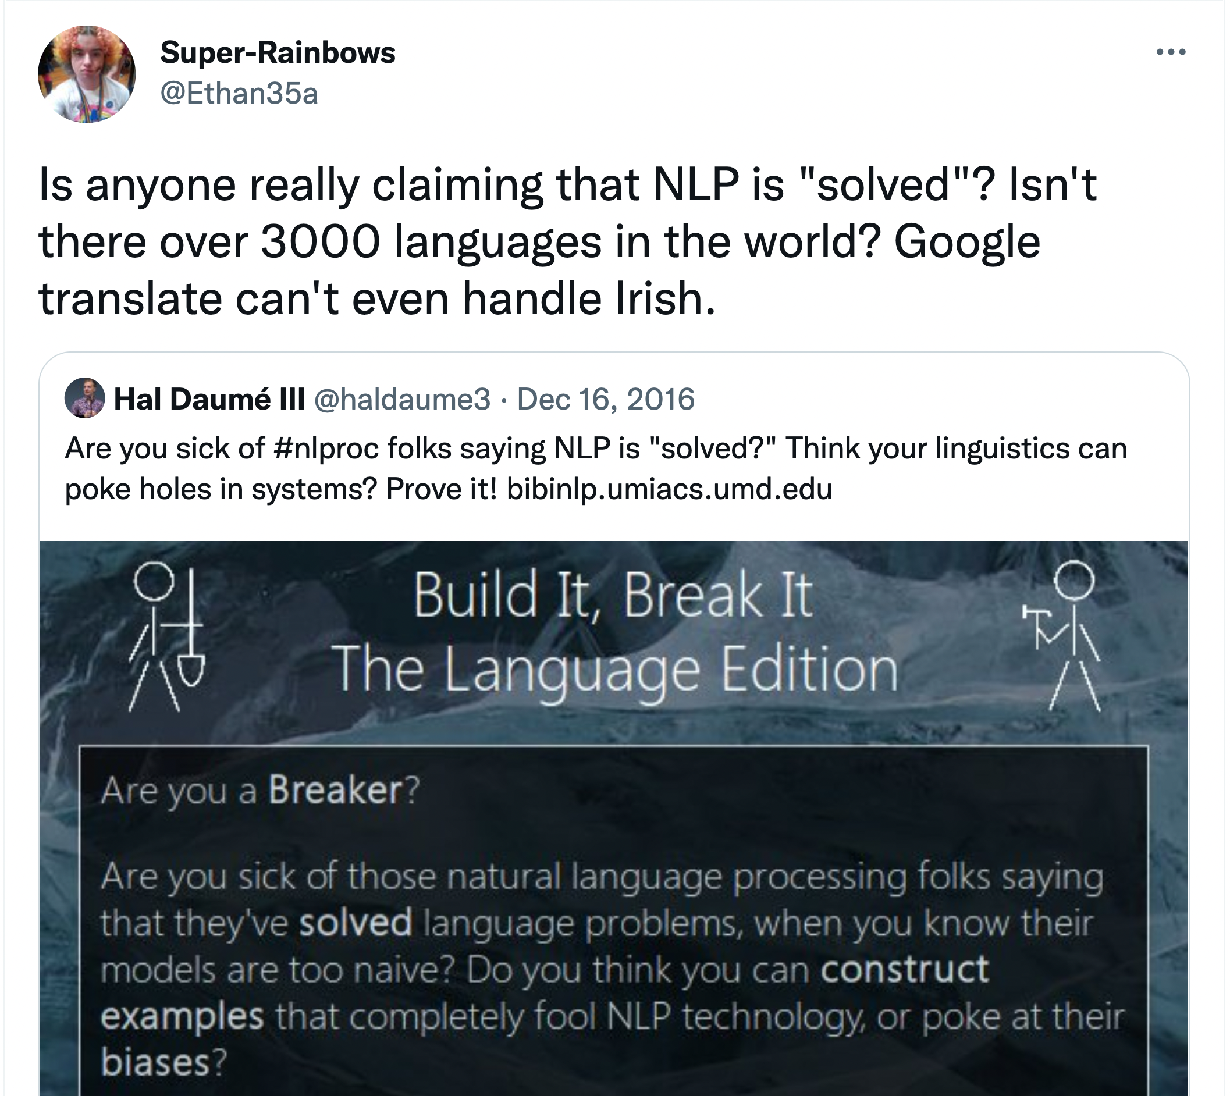
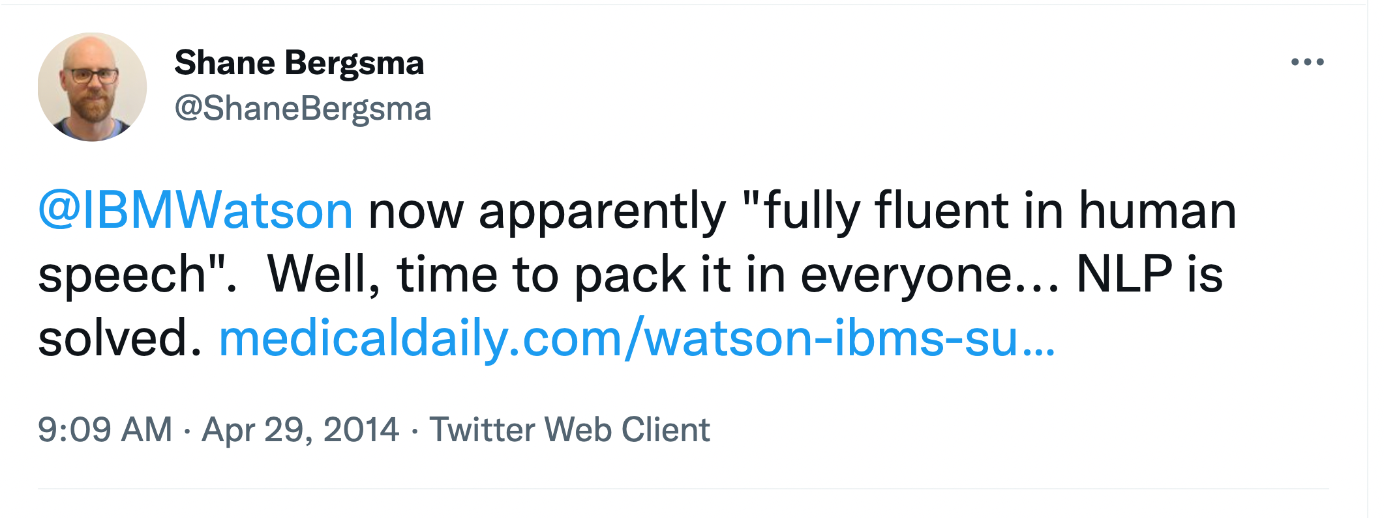
NLP Talk of the Town
1.
2.
Credits: https://twitter.com/search?q="NLP is solved”

Slide 4
Background
Zipfian distribution of word types head: a few types have a lot of tokens long-tail: a lot of types have only a few tokens each
Learning the distribution head gets us an initial working prototype
Machine learning is very promising at this stage
Notes:
e.g., Brown corpus (English): 46.5% tokens from top 50 types 90% % tokens from 6000 types; and 95.45% are from 14.5k types

Slide 5
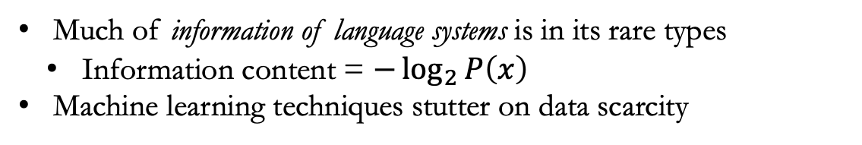
Long-tail: Curse
Much of information of language systems is in its rare types
Information content = $−\log_{2}{P\left(x\right)}$
Machine learning techniques stutter on data scarcity
(1) NLP is not solved, not even MT; let me tell you about the long-tail

Slide 6
Multilingual NMT
There are 7000+ languages on earth
Commercial MT support *checked on Nov 2021
Google Translator: 107-to-107 languages *
Microsoft Translator: 104-to-104 languages
DeepL: 25-to-25 languages
All the above are based on proprietary datasets
Research
Facebook AI’s Translator: 100-to-100 languages
OPUS100: 100-Eng and Eng-to-100
Google’s
Can we say NLP is solved without having an AI that can translate any language to the one we can understand (e.g. English)
We train 500-to-English model in an open-source way

Slide 7
Thesis Statement
Rare words are important,
They carry a lot of information content
They are hard to learn
Currently, we have fluency in NLG, but adequacy is subpar
The importance of rare words are overlooked
Just like rare words, even the rare languages are overlooked
In this work,
More emphasis on learning rare word types, i.e., long tail

Slide 8
Thesis Statement
Background:
Natural language types resemble a Zipfian distribution
Frequent types are function words
Contribute to fluency
Rare types are content words
Contribute to adequacy
Information theory on Zipfian distribution: much of information content of a language system is in its long tail of rare types
Machine learning on Zipfian distribution
Easy, if rare types can be ignored
Hard, if rare types cannot be ignored
Rare types are especially important; so, they cannot be ignored
But rare types are statistically indistinguishable from noise
Currently, the importance of rare types is overlooked we have fluent systems, but adequacy is often sub-par
We propose techniques at training and evaluation time that emphasize the long-tail of rare types and target more information content
Breakdown:
Study the effect of type imbalance on NLG/NMT Prove that imbalance is problematic for NLG
Study the current evaluation techniques wrt to class imbalance (and show their weakness). Propose an evaluation technique that addresses class imbalance.
Imbalanced learning methods for NLG

Slide 9
Dealing with the Long-tail
Modeling
Evaluation
Applications
Scaling NMT to 500+ languages on source side [ACL2021 Demos]
Equal emphasis on rare classes/types [NAACL2021]
Hyper parameter selection to address long tail [EMNLP2020]
[EMNLP 2020 Findings] Gowda and May. "Finding the Optimal Vocabulary Size for Neural Machine Translation.”
[NAACL 2021] Gowda et al "Macro-Average: Rare Types are Important Too.”
[ACL 2021 Demos] Gowda et al "Many-to-English Machine Translation Tools, Data, and Pretrained Models.”

Slide 10
Collaborators
Jonathan May (advisor), USC ISI
Scott Miller, USC ISI
Chris Mattamann, USC & JPL
Weiqiu You, U Penn
Zhao Zhang, UT & JPL
Constantine Lignose, Brandeis University
Acknowledgements
USC Employee Benefits (Tuition Assistance)
DARPA LORELEI
IARPA MATERIAL
DARPA LwLL

Slide 11
Vision / Perspective

Slide 12
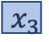
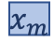

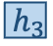
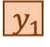
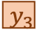
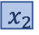
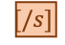
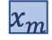
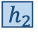
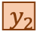
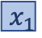
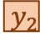
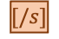
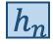
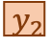
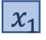
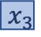
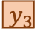
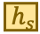
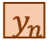
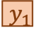
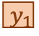
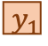
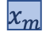
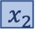
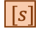
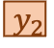
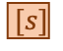
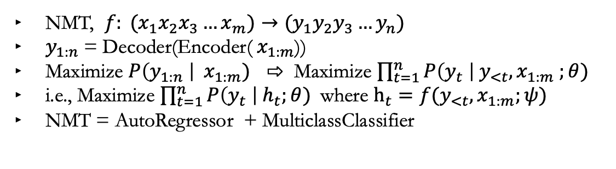
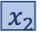
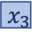
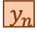
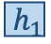
Neural Machine Translation
NMT, $f: (x_{1}x_{2}x_{3}…x_{m})→{(y}_{1}y_{2}y_{3}…y_{n})$
$y_{1:n}$= Decoder(Encoder(${ x}_{1:m}$))
Maximize $P\left(y_{1:n} \right| { x}_{1:m})$ ⇨ Maximize $\prod_{t=1}^{n}{P\left(y_{t} \right| y_{<t}, x_{1:m} ;θ)}$
i.e., Maximize $\prod_{t=1}^{n}{P\left(y_{t} \right| h_{t};θ)}$where $h_{t}=f(y_{<t}, x_{1:m};ψ)$
NMT = AutoRegressor + MulticlassClassifier
Evolution
Abstraction
$$y_{1}$$
$$y_{2}$$
$$y_{3}$$
…
$$[/s]$$
$$y_{1}$$
$$y_{2}$$
$$y_{3}$$
…
$$[/s]$$
x-Attention
MULTICLASS CLASSIFIER
…
DECODER
$$x_{1}$$
$$x_{2}$$
$$x_{3}$$
$$x_{m}$$
$$h_{s}$$
Self Attn
ENCODER
$$h_{1}$$
$$h_{2}$$
$$h_{3}$$
$$h_{n}$$
Self Attn
$[s]$
$$y_{1}$$
$$y_{2}$$
…
$$y_{n}$$
x-Attention
AUTOREGRESSOR
…
Encoder
Self-Attention
$$x_{1}$$
$$x_{2}$$
$$x_{3}$$
$$x_{m}$$
RNN LSTM, GRU
Bi RNN
+Attn
CNN
- RNN -Bottleneck
Transformer RNN, CNN +FF +SelfAttn
…
…
$$x_{1}$$
$$x_{2}$$
$$x_{3}$$
$$x_{m}$$
$$[s]$$
$$y_{1}$$
$$y_{2}$$
$$y_{n}$$

Slide 13
Imbalanced Classification Learning
Classification problem: output variable is discrete e.g., word types in
Imbalanced classification: unequal frequency distribution of classes i.e., some classes are frequent → majority class(es) and others are rare → minority class(es)
Problem: Frequency based biases degrades overall performance
Minority classes are ignored → poor recall
Special care is required during evaluation; otherwise, metrics give false sense of confidence on model performance
E.g., cancer detection with 1 : 99 imbalance; majority label gets 99% overall accuracy
Examples
Cancer detection: fewer positive than negative accuracy
Image segmentation: “background pixel” is more prevalent than foregrounds
NLP: stopword types have more tokens each than content word types

Slide 14
Imbalanced Learning Methods
Sampling methods:
Up-sampling /over-sampling, Sown-sampling / under-sampling, Synthetic Minority Over-sampling (SMOTE) ➔ Not possible: types are imbalanced, but sampling works on sequences
Weighted loss functions:
Weighted cross entropy
Focal-loss
Adaptive learning methods such as ADAM achieves a similar effect
Byte Pair Encoding (BPE) Balancing via splitting and merging of classes in a sequence
Tuning the vocabulary size improves class balance ✅

Slide 15
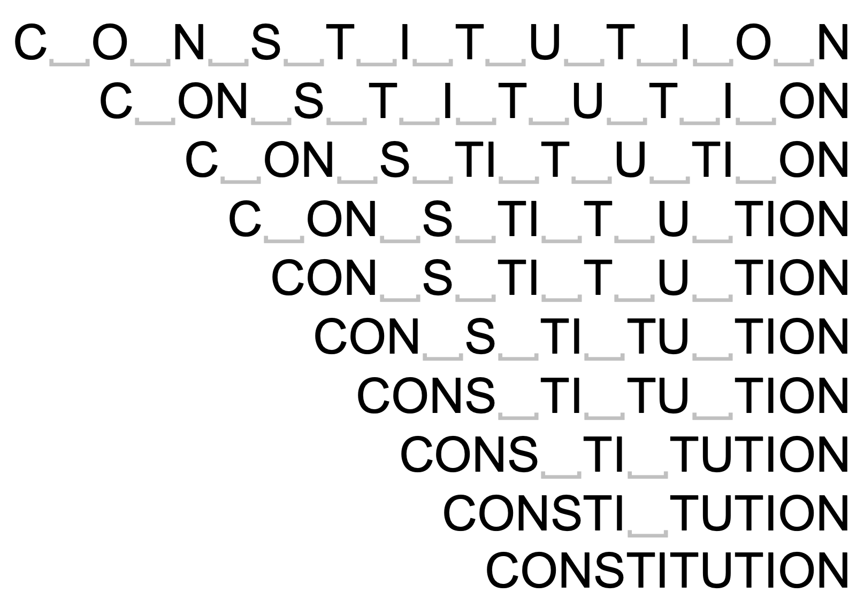
BPE Subwords
Split/merge classes; modifies class distribution
Byte-pair-encoding subwords [Sennrich et al 2016] addresses open-vocabulary generation
Subwords are obtained by merging chars ➔ gets better performance than chars and words
Number of merges is a hyper parameter
Why are some vocabulary sizes better than others?
WORD ⇦BPE ⇨ CHARS

Slide 16
Experiments
Four target languages: DE→EN, EN→DE, EN→HI, and EN→LI
Total of 11 dataset sizes: between 30K and 4.5M sentences
x10 vocabulary sizes: Chars, 500, 1K, 2K, 4K, 8K, 16K, 32K, 48K, and 64K
Transformer with 6 Layers, 512 Dim, 8 Heads, 0.1 Dropout, …
16,000 warmup steps followed by inverted sqrt decay; training stops when the validation loss start to climb up
Beam decoder, length penalty, checkpoint averaging …
Separate vocabs for source and target Decoder’s input and output embeddings are tiedx

Slide 20
Some BPE vocabulary sizes are better than others;
Why?

Slide 21
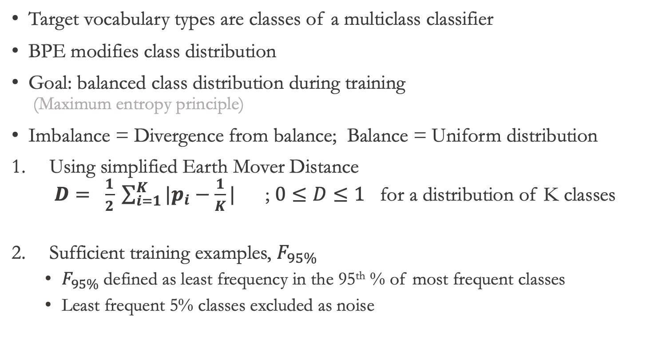
Classifier (C)
Target vocabulary types are classes of a multiclass classifier
BPE modifies class distribution
Goal: balanced class distribution during training (Maximum entropy principle)
Imbalance = Divergence from balance; Balance = Uniform distribution
Using simplified Earth Mover Distance $D= \frac{1}{2} \sum_{i=1}^{K}{|p_{i}−\frac{1}{K}|}$ ; $0≤D≤1$ for a distribution of K classes
Sufficient training examples, $F_{95\%}$
$F_{95\%}$ defined as least frequency in the 95th % of most frequent classes
Least frequent 5% classes excluded as noise

Slide 22
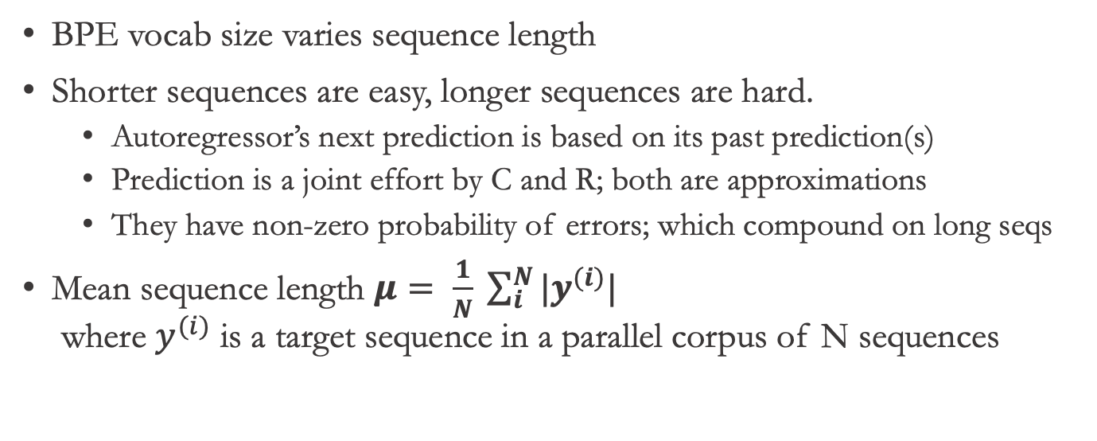
AutoRegressor (R)
BPE vocab size varies sequence length
Shorter sequences are easy, longer sequences are hard.
Autoregressor’s next prediction is based on its past prediction(s)
Prediction is a joint effort by C and R; both are approximations
They have non-zero probability of errors; which compound on long seqs
Mean sequence length $μ= \frac{1}{N} \sum_{i}^{N}{{|y}^{(i)}|}$ where $y^{(i)}$ is a target sequence in a parallel corpus of N sequences

Slide 23
Effect of BPE
As BPE merge operations increase
Sentence length decreases
Class imbalance increases*
We need both length and divergence to be small
Best vocab size is the one that reaches a good trade-off

Slide 24
Heuristic
“Use the largest possible BPE vocabulary such that at least 95% of classes have about 100 or more training examples”

Slide 25
Effect of Imbalance on NMT Modeling
Some BPE vocabulary sizes better than others
Frequency-based bias on classes i.e. correlation between class frequency and performance

Slide 26
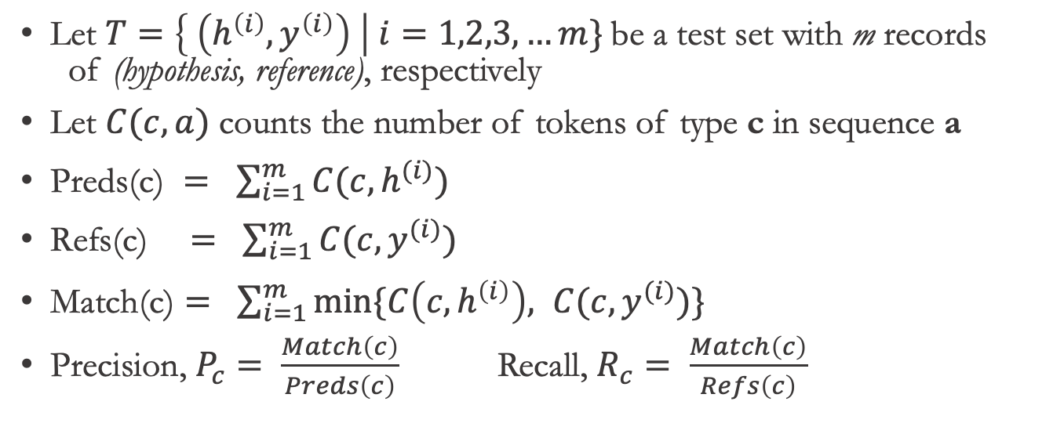
Class Performance
Let $T=\left\{ \left(h^{\left(i\right)},y^{\left(i\right)}\right) \right| i=1,2,3, …m\}$be a test set with m records of (hypothesis, reference), respectively
Let $C(c, a)$ counts the number of tokens of type c in sequence a
$\text{Preds}\text{(}\text{c}\text{) }= \sum_{i=1}^{m}{C(c, h^{(i)})}$
$\text{Refs}\text{(}\text{c}\text{)} = \sum_{i=1}^{m}{C(c, y^{(i)})}$
$\text{Match}\text{(}\text{c}\text{)}= \sum_{i=1}^{m}{min⁡\{C\left(c, h^{\left(i\right)}\right), C(c, y^{(i)})}\}$
Precision, $P_{c}= \frac{Match\left(c\right)}{Preds\left(c\right)}$ Recall, $R_{c}= \frac{Match\left(c\right)}{Refs\left(c\right)}$

Slide 27
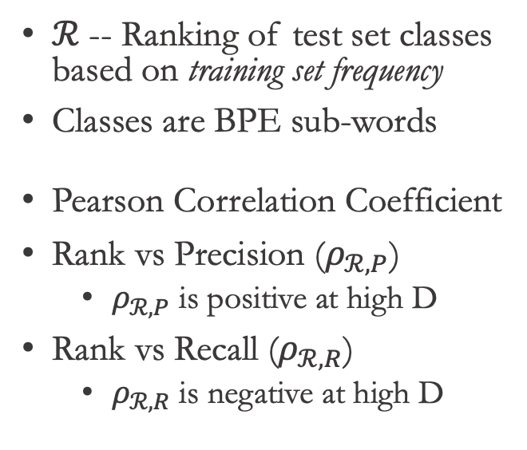
Frequency-based Bias on Class Performance
$ℛ$ -- Ranking of test set classes based on training set frequency
Classes are BPE sub-words
Pearson Correlation Coefficient
Rank vs Precision ($ρ_{ℛ,P}$)
$ρ_{ℛ,P}$ is positive at high D
Rank vs Recall ($ρ_{ℛ,R}$)
$ρ_{ℛ,R}$ is negative at high D

Slide 28
Evaluating MT as a Multi-class Classifier on Imbalanced Test Sets

Slide 29
Motivation
Based on term frequencies from Brown Corpus; ~1M tokens, ~50K types
Imbalanced types
Machine learning techniques suffer from class imbalance
Favor the frequent types out-of-the-box
Rare types are important [“Last words”, Steedman, 2008]
“Extra care” is needed to favor the rare types
During modeling (recent: Gowda & May, 2020)
During evaluation (this work)
- log₂ P(x)
P(x)
Notes:
We have imbalanced types
ML techniques we use (say classifiers), they suffer from data imbalance and scarcity
If frequent types are the ones we care, then we are in luck..
But the rare types are important
So, we need extra care while applying ML on this distribution
In our past work, we showed how certain hyper params such as BPE vocabulary influence imbalance, and showed frequency based biases that exist in NMT models
In this work, we focus on evaluation

Slide 30
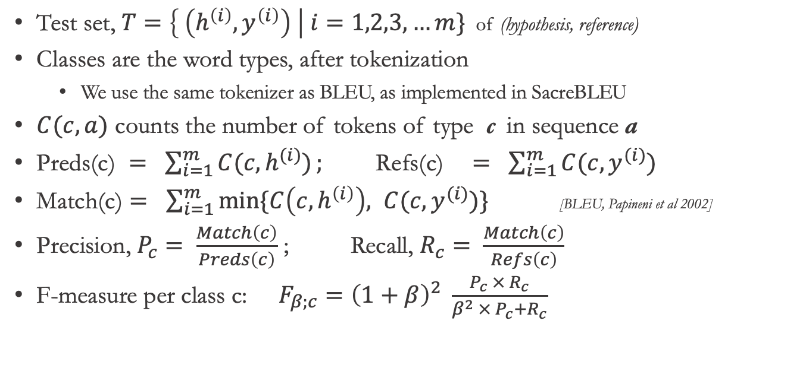
Class Performance
Test set, $T=\left\{ \left(h^{\left(i\right)},y^{\left(i\right)}\right) \right| i=1,2,3, …m\}$ of (hypothesis, reference)
Classes are the word types, after tokenization
We use the same tokenizer as BLEU, as implemented in SacreBLEU
$C(c, a)$ counts the number of tokens of type c in sequence a
$\text{Preds}\text{(}\text{c}\text{) }= \sum_{i=1}^{m}{C(c, h^{(i)})}; \text{Refs}\text{(}\text{c}\text{)} = \sum_{i=1}^{m}{C(c, y^{(i)})}$
$\text{Match}\text{(}\text{c}\text{)}= \sum_{i=1}^{m}{min⁡\{C\left(c, h^{\left(i\right)}\right), C(c, y^{(i)})}\}$ [BLEU, Papineni et al 2002]
Precision, $P_{c}= \frac{Match\left(c\right)}{Preds\left(c\right)}$ ; Recall, $R_{c}= \frac{Match\left(c\right)}{Refs\left(c\right)}$
F-measure per class c: $F_{β;c}={\left(1+β\right)}^{2} \frac{P_{c} × R_{c}}{β^{2} ×{ P}_{c}+R_{c}}$
Notes:
How do we evaluate Classifiers?
We take a test set,
tokenize it -- word types are our classes
Similar to BLEU, we compute match based on predictions, references, and common
Then we compute Precision, the same way as BLEU.. But the difference here is BLEU computes one precision for all unigrams, it doesn't compute precision for each class or type, e.g. it doesnt tell whats the precision for type ‘the’ , but we do... we compute for each type from reference and hypothesis Similarly, we compute recall for each type
And then F-measure for each type
We are all doing this for evaluating classifiers

Slide 31
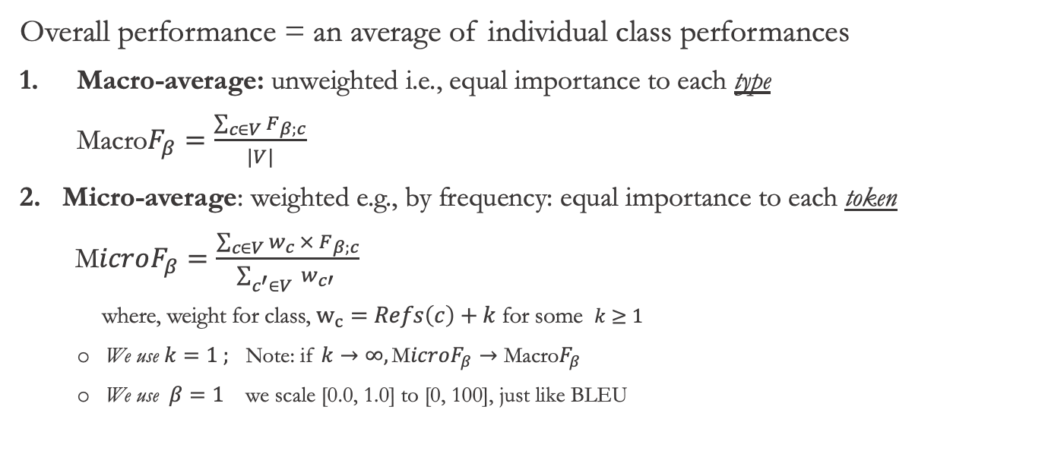
Multiclass Classifier Performance
Overall performance = an average of individual class performances
Macro-average: unweighted i.e., equal importance to each type $\text{Macro}F_{β}=\frac{\sum_{c∈V}{F_{β;c}}}{|V|}$
Micro-average: weighted e.g., by frequency: equal importance to each token $\text{M}icroF_{β}=\frac{\sum_{c∈V}{w_{c} × F_{β;c}}}{\sum_{c^{′}∈V}{ w_{c′} }}$
where, weight for class, $w_{c}=Refs\left(c\right)+k$ for some $k≥1$
We use $k=1 ;$ Note: if $k→∞, \text{M}icroF_{β}→\text{Macro}F_{β}$
We use $β=1$ we scale [0.0, 1.0] to [0, 100], just like BLEU
Notes:
So far, we have F-measure for each type, how do we summarize it to a single number?
We take an average over all types – but how do we average, this is where crucial detail is
We have two options:
First, an unweighted average aka macro average, in this case, we assign equal weight to each type.
Second, we have weighted average aka micro average. In this case, we pick frequencies in the reference side as weight... that's roughly equivalent to treating each token equally.
BLEU, for instance is precision metric -- what kind of precision ? it is Micro-averaged precision

Slide 32
MacroF1 vs Others
Frequency Imbalance
Equal weight
WMT 19 DE-EN NewsTest: MacroF1 has equal weight for all types
Micro-averaged metrics overlook improvements from rare types, after rounding to one or two decimals
Notes:
Before we go into details, here is how macro-average is different than the rest. What are we visualizing here ? We replaced types with an OOV type of same number of chars (same chars so length penalty is not in effect), and computed the drop in corpus level score. That’s a proxy for maximum reward a metric offer for correctly learning to translate a type.
Also showing frequencies in the blue line in top. we see --
MicroF1 treats each token equally – so MicroF1 in purple is roughly resembling the shape of frequency
MacroF1 assigns equal weight to each type – so we see a horizontal line in orange.
BLEU and CHRF are more like MicroF than MacroF. They have spikes and surges because of different number n-grams affected by each type. BLEURT scores are not in an interpretable range. So not shown here.
The takeaway is -- the reward from micro-averaged metrics for rare words is in two to three decimal points
Since we generally round the corpus score to just one decimal point, there is a good chance that gain from rare types are easily overlooked

Slide 33
Justification for MacroF1 as an MT evaluation metric
Compare MacroF1 with
BLEU and ChrF1 – popular options
MicroF1 – so we can see the difference micro and macro avg makes
BLEURT – model-based metric based on BERT
BLEURT has undesirable biases, shown in paper (not talking about here)
On these Tasks
Data-to-text: Fluency and Semantics: WebNLG
Machine Translation: Translation quality : WMT Metrics 2017-19
CLIR: IR Task performance: CLSSTS 2020
CLIR: ASR task performance: (IARPA MATERIAL program)
Notes:
Will this simple metric work for MT evaluation? We shall do a comparison

Slide 34
Justification for MacroF1
Macro-F1 is commonly used for evaluating classifiers on imbalanced test sets
Compare MacroF1 with MicroF1, BLEU, ChrF1, and BLEURT
MicroF1, BLEU, and ChrF1 are micro-averaged metrics BLEURT is BERT model finetuned to predict human judgement score
WebNLG data-to-text Task: Correlation with Fluency, Grammar, and Semantics; on English only
WMT Metrics Task 2017-2019 Correlation with direct human assessments on tens of languages
Workshop on CLSSTS 2020 Correlation with downstream CLIR task performance on LT-EN, PS-EN, BG-EN
Notes:
Cross-Language Search and Summarization of Text and Speech http://users.umiacs.umd.edu/~oard/clssts/

Slide 35
WebNLG Data-to-Text Evaluation
Correlation with Fluency, Grammar, and Semantics on English only
MacroF1 is a poor indicator of Fluency + Grammar, but one of the strong indicators of Semantics

Slide 36
WMT Metrics: Wins per Metric
Wins = Number of times a metric scored highest correlation with human judgements
*BLEU is from the WMT metrics package, precomputed by task organizers
MacroF1 and MicroF1 use the same tokenizer as BLEU, obtained using SacreBLEU
MacroF1 has more wins in the recent year -- when systems are mostly fluent, adequacy is a key discriminator
Notes:
*BLEU is from the metrics package, precomputed by task organizers
BLEU is our own calculations. MacroF1 and MicroF1 share the same tokenizer as BLEU

Slide 37
CLIR Task: Pipeline
IR task with queries and docs in different languages
Build a set of MT models; translate all source documents to the target language, compute MT metric(s)
For each MT model’s translations, build an IR model, and measure IR metrics
Find the correlation between the set of MT scores and IR scores. The MT metric having stronger correlation with IR metric(s) is more useful than others.
Repeat this on many languages CLSSTS 2020 datasets: LT-EN, PS-EN, BG-EN
Source Docs
Source -> English
Machine Translation
Source -> English Human Translation
Translated Docs (English)
MT Metric
Queries
(English)
IR System
MT score
Query x Doc Rankings by IR
Query x Doc
by Humans
IR Metric
IR score
Correlation

Slide 38
Downstream CLIR Task (CLSSTS 2020)
IR task with queries and docs in different languages
Translate source docs to target language, and match queries with docs
MT metric having strong correlation with IR metric (e.g. mAP) is more useful
MacroF1 is the strongest indicator of downstream IR task performance
Notes:
About mAP: https://blog.paperspace.com/mean-average-precision/

Slide 39
MacroF1 for MT Evaluation
BLEU treats each ‘token’ equally
Stopword types have significantly higher weight than content word types
Rare/Content types are important too [Gowda et al, NAACL 2021]
💡Treat each ‘type’ equally, regardless of frequency ➔ Macro-average e.g., MacroF1
MacroF1 is competitive on MT evaluation; e.g., direct human assessment in WMT Metrics
MacroF1 is the strongest indicator of downstream CLIR performance e.g., mAQWV in MATERIAL ANALYSIS sets
Macro-averaged ASR evaluation metric?
WER, like BLEU, also treats each token equally instead of each type equally
MT test set : ANALYSIS CLIR test set: QUERY1 on DEV+ANALYSIS
Notes:
Add AQWV vs MacroF1 graphic

Slide 40
MacroF1 for ASR Evaluation
Which ASR metric is the best indicator of downstream CLIR task performance?
Word error rate (WER)
Match error rare (MER)
Word information preserved (WIP)
Other metrics: BLEU, MicroF1, MacroF1
Correlation between ASR metrics and AQWV
Using Kendall’s rank coefficient, 𝜏
➔MacroF1 is a strong indicator, on Pashto (2C) (with over 99% confidence)
Other languages? we don’t have enough datapoints; [WIP]
Notes:
Just show 2C; make a viz
And remove others – say not enough samples
Give us your ASR outputs on analysis?

Slide 41
Difference Between Supervised and Unsupervised NMT Performance (Collaboration with Weiqiu You)

Slide 42
SNMT vs UNMT: BLEU and MacroF1
In terms of BLEU, UNMT and SNMT performance is comparable*,
but MacroF1 shows significant differences between SNMT ​and UNMT
* SNMT systems were chosen to match BLEU scores with UNMT
Notes:
For one SNMT and one UNMT system that have similar BLEU score, their Macro F1 score differ on 5 out of 6 languages. In all the languages, SNMT systems have better MacroF1 scores than UNMT systems.​
​
Unsupervised neural machine translation systems trained on massive monolingual data without parallel corpora have made significant progress recently. We are then interested in the question that when an unsupervised neural machine translation system (which we refer to as UNMT) and a supervised neural machine translation system (which we refer to as SNMT) have the same BLEU score, are there any qualitative differences that set them apart. Here we select such systems in three language pairs, and to our surprise, MacroF1 alone already shows the differences. Despite having similar BLEU scores, SNMT systems always have better MacroF1 scores than their UNMT counterparts.​

Slide 43
MacroF1 Difference Between SNMT and UNMT
UNMT has better performance on frequent types, but SNMT outperforms on rare types ⇨ Approximately same BLEU but a huge difference in MacroF1
Content types have significantly lower F1 score than stopwords such as ‘the’.
Other metrics do-not offer this level of breakdown. Try: BLEU, CHRF, BLEURT
UNMT > SNMT
SNMT > UNMT
Notes:
For one SNMT and one UNMT system that have similar BLEU score, their Macro F1 score differ on 5 out of 6 languages. In all the languages, SNMT systems have better MacroF1 scores than UNMT systems.​
​
Unsupervised neural machine translation systems trained on massive monolingual data without parallel corpora have made significant progress recently. We are then interested in the question that when an unsupervised neural machine translation system (which we refer to as UNMT) and a supervised neural machine translation system (which we refer to as SNMT) have the same BLEU score, are there any qualitative differences that set them apart. Here we select such systems in three language pairs, and to our surprise, MacroF1 alone already shows the differences. Despite having similar BLEU scores, SNMT systems always have better MacroF1 scores than their UNMT counterparts.​

Slide 44
MacroF1 Difference Between SNMT and UNMT
Similar trend across all languages: SNMT is better than UNMT on rare words
Notes:
For one SNMT and one UNMT system that have similar BLEU score, their Macro F1 score differ on 5 out of 6 languages. In all the languages, SNMT systems have better MacroF1 scores than UNMT systems.​
​
Unsupervised neural machine translation systems trained on massive monolingual data without parallel corpora have made significant progress recently. We are then interested in the question that when an unsupervised neural machine translation system (which we refer to as UNMT) and a supervised neural machine translation system (which we refer to as SNMT) have the same BLEU score, are there any qualitative differences that set them apart. Here we select such systems in three language pairs, and to our surprise, MacroF1 alone already shows the differences. Despite having similar BLEU scores, SNMT systems always have better MacroF1 scores than their UNMT counterparts.​

Slide 45
Scaling NMT to 500 Languages
Data
Model
Tools

Slide 46
Multiligual NMT
There are 7000+ languages on earth
Commercial MT support *checked on Nov 2021
Google Translator: 107-to-107 languages *
Microsoft Translator: 104-to-104 languages
DeepL: 25-to-25 languages
All the above are based on proprietary datasets
Researchy
Facebook AI’s Translator: 100-to-100 languages
OPUS100: 100-Eng and Eng-t0-100
Google’s
We train 500-to-English model in an open-source way

Slide 47
500 Languages..
Where are the datasets?
WMT and Statmt.org
OPUS
Facebook AI Research
Paracrawl
Bible(s) and JW.org derived datasets
Datasets derived from European and Candian govt. sites
United Nations corpus
Wikipedia titles / Wikimedia …
WAT
IITB, JoshuaDecoder,
…. (anything I could hold my hands on)
Created a downloader tool and made it free/open; mtdata

Slide 48
Scaling NMT to 500 Languages

Slide 49
Scaling NMT to 500 Languages

Slide 50
Tools
Focus: reproducibility and scalability
MTData: parallel dataset catalog and downloader
As of June 2021, 120K+ datasets, hundreds of languages; ISO 639-3
Publicly listed datasets: OPUS, Statmt.org, Paracrawl, ...
NLCodec: Vocabulary manager; and database layer
PySpark backend for large datasets
NLDb: Efficient storage and retrieval layer; parallelizable
Reader Translator Generator (RTG): NMT toolkit based on Pytorch
Reproducible experiments; a conf.yml per experiment
All the necessary ingredients for NMT research → production
pip install mtdata nlcodec rtg

Slide 51
mtdata: dataset catalogue and downloader
pip install mtdata github.com/thammegowda/mtdata/
$ mtdata list [-l lang1-lang2] [-n <name>]
$ mtdata get -l lang1-lang2 --out /path/to/dir --merge --train name1 name2 … --test name1 name2 …
ISO 639-3 codes and names [7000+ language codes] $ mtdata-iso <lookup>
Data sources: OPUS, Statmt, Paracrawl, UNPC,… ELRC-Share* …
Data formats: XML, SGM, TMX, TSV, … .tar, .zip, .tgz, .gz, .bz2, .xz …
Avoids repetitive downloads by managing a local cache
Hundreds of languages, ~125K datasets as of now *thanks to Kenneth Heafield

Slide 52
NLCodec: Vocabulary Manager and Training Data Storage
isi-nlp.github.io/nlcodec/ pip install nlcodec
Vocabulary types: word, char, BPE subword
Python implementation with PySpark backend (scalable!)
Optimized storage for variable length integer sequences
Efficient storage helps keep large chunks of data in RAM for random lookups
Up to 255 (e.g., chars) 1-byte; up to 65.5K (e.g., BPE subwords) 2-bytes
Horizontal sharding: parallel writes (data prep on Spark) and parallel reads (e.g., distributed training)
CLI, in addition to Python API:
$ nlcodec [learn|encode|decode] …
$ nlcodec-db …

Slide 53
RTG: NMT toolkit
https://isi-nlp.github.io/rtg/ pip install rtg
Based on PyTorch
Reproducible experiments: all hyper params in a conf.yml
Packs all the necessary ingredients for NMT research → production
Data distributed parallel (multi-node multi-GPU) and FP16/mixed-precision training
Transfer learning, weight tying, freezing some layers,
Beam search, length penalty, gradient accumulation, …
Flexible vocabulary options: sentencepiece, and nlcodec; shared or separate
CLI: rtg-pipe, rtg-decode, rtg-export, rtg-serve …
rtg-pipe /path/to/exp-dir # assumption conf.yml inside the dir
Model serving via REST API and minimal web interface in addition to CLI

Slide 54
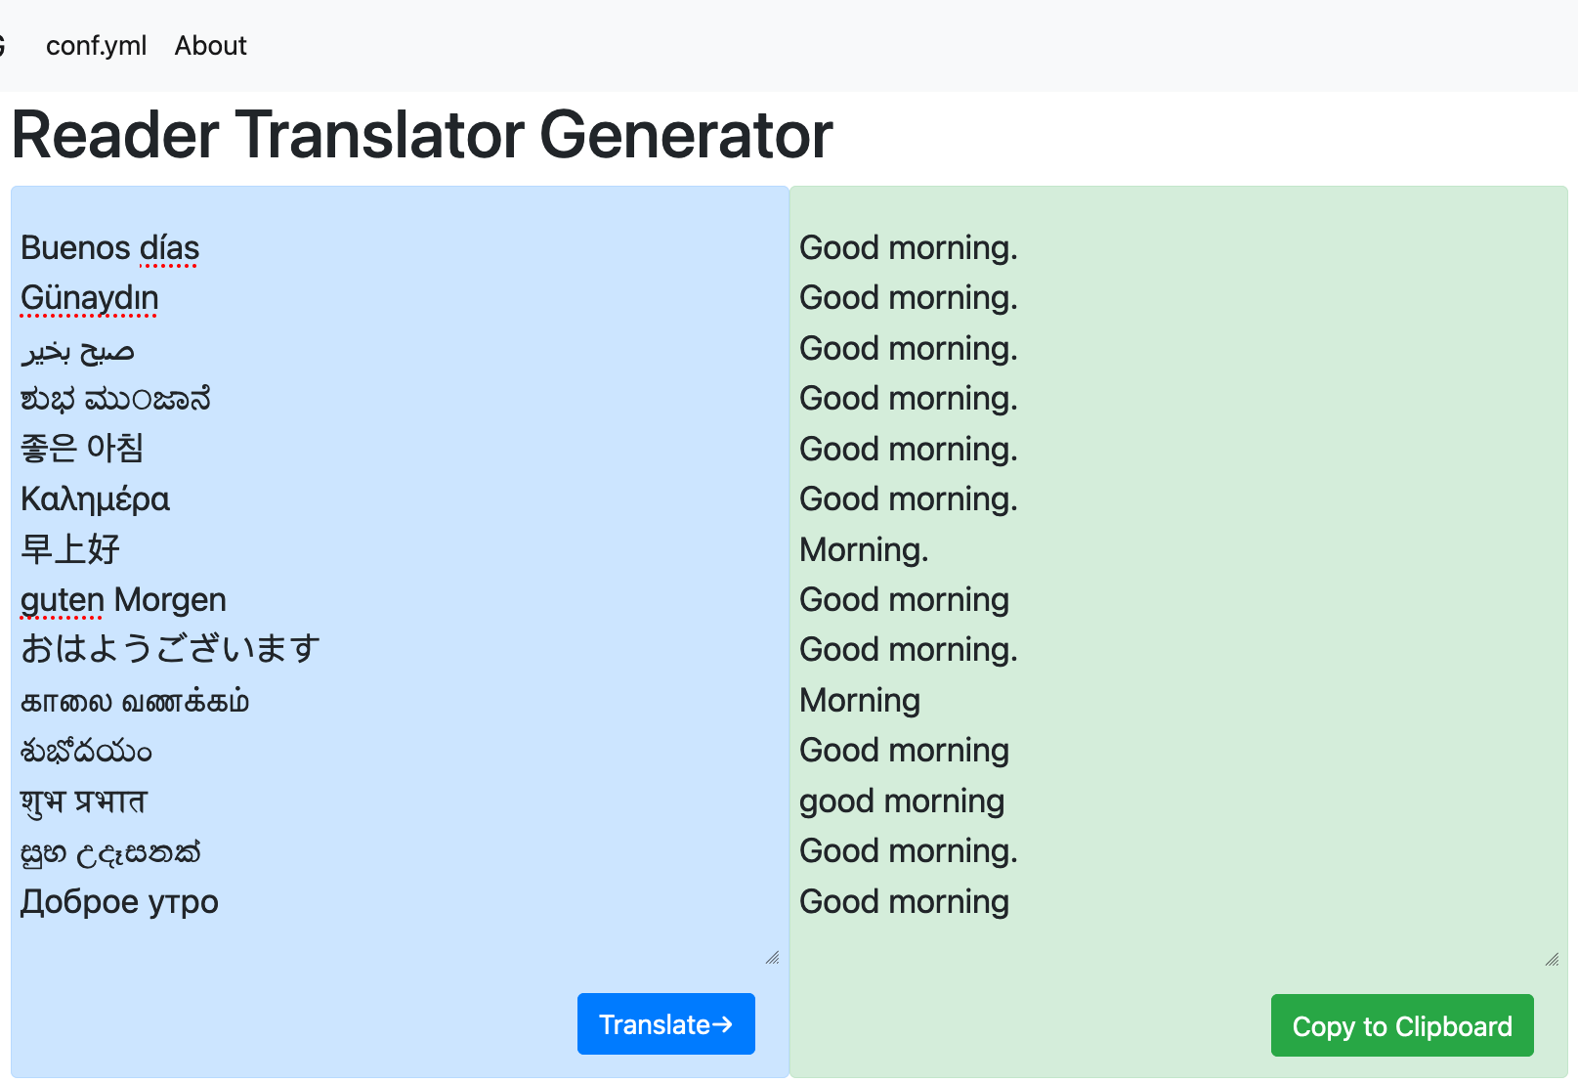
500-English NMT
MTData : download datasets NLCodec: prepare store training data RTG : train NMT models and serve
Our largest NMT experiment so far
500 source langs; 9 billion tokens
Transformer, 768dims 9 Encoder 6 Decoders
512k source and 64k target embeddings
http://rtg.isi.edu/many-eng/
Datasets, pretrained models, and usage guide
$ docker run --gpus '"device=0”’ --rm –i \
-p 6060:6060 tgowda/rtg-model:500toEng-v1
RTG Web UI
REST API behind the scenes (via AJAX)

Slide 55
500→English Translation
Dataset: 500+ languages
Dedupe, cleaning, etc ...
Excluding the known test sets e.g. NewsTest, OPUS-100, ...
➔ ~474 million sentence pairs; 9 billion tokens on each side
Model: Transformer: 768d, 9 encoder, 6 decoder,
Separate BPE vocabularies: 512k source and 64k target embeddings
Large batches: ~720k toks per step, 200K steps
Gradient accumulation (5x), Float-16 ops, and distributed training on 8x A100 GPUs
Thanks to TACC and Zhao Zhang

Slide 56
Translation Service: BLEU on OPUS-100 Test Set
Notes:
4x more languages. the performance is comparable, sometimes better than more sophisticated models; Zhang et al has deep model of 24 layers, with language aware layer norm, layer transform, robust backtranslation etc...
A few cases where our model has poor performance is due to test sets having short sentences; since we are not informing a source language, short sentences, especially single words and phrases without context can be confusing to this 500-Eng multilingual model
It is competitive with the best known results on these test sets

Slide 57
Transfer Learning: Fine Tuning
E.g., two low-resource langs BRE: 1.2M ENG toks SME: 100K ENG toks
Huge improvements in BLEU!
Model | BRE-ENG | SME-ENG
Baseline | 12.7 | 10.7
500-eng parent | 11.8 | 8.6
Finetuned | 22.8 | 19.1

Slide 58
Translation Service: BLEU on OPUS-100 Test Set
Notes:
4x more languages. the performance is comparable, sometimes better than more sophisticated models; Zhang et al has deep model of 24 layers, with language aware layer norm, layer transform, robust backtranslation etc...
A few cases where our model has poor performance is due to test sets having short sentences; since we are not informing a source language, short sentences, especially single words and phrases without context can be confusing to this 500-Eng multilingual model
It is competitive with the best known results on these test sets

Slide 59
Transfer Learning: Fine Tuning

Slide 60
MATERIAL 9-Eng Results: MacroF1 on Analysis Sets
“Previous best” : the best bilingual models used in evals; separate for each language
Notes:
“Previous best” is the one we have used during evaluation; the best among dozens of models we have for each language.

Slide 61
Software/Tools
Reader Translator Generator
MTData
NLCodec
Sacrebleu+MacroF

Slide 62
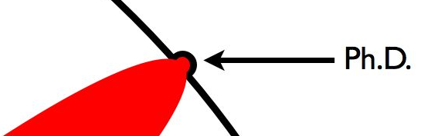
Contributions
 | Before | After
NMT Architecture | Autoencoder: i.e., Encoder-Decoder | Autoregressor + Classifier ^{[1]}; More emphasis on the vocabulary
Vocabulary Size | Did not know why some are best; Arbitrarily chosen or via grid search for each dataset | Vocabulary is a set of classes; Byte pair-encoding (BPE) size is chosen to minimize sequence lengths and improve class balance ^{[1]}
Evaluation Metrics | Treat each ‘token’ equally; Stopwords have more weight | Rare word types are important too. Treat each ‘type’ equally ^{[2]}; All types have equal weight
Scaling NMT | To ~100 languages | To ~500 languages ^{[3]}
[1] Gowda and May, EMNLP 2020 Findings; ‘Finding the optimal vocabulary size for NMT’
[2] Gowda et al, NAACL 2021; ‘Macro-average: Rare types are important too’
[3] Gowda et al, ACL 2021 Demos; ‘Many-to-English tools, data, and pretrained models’

Slide 63
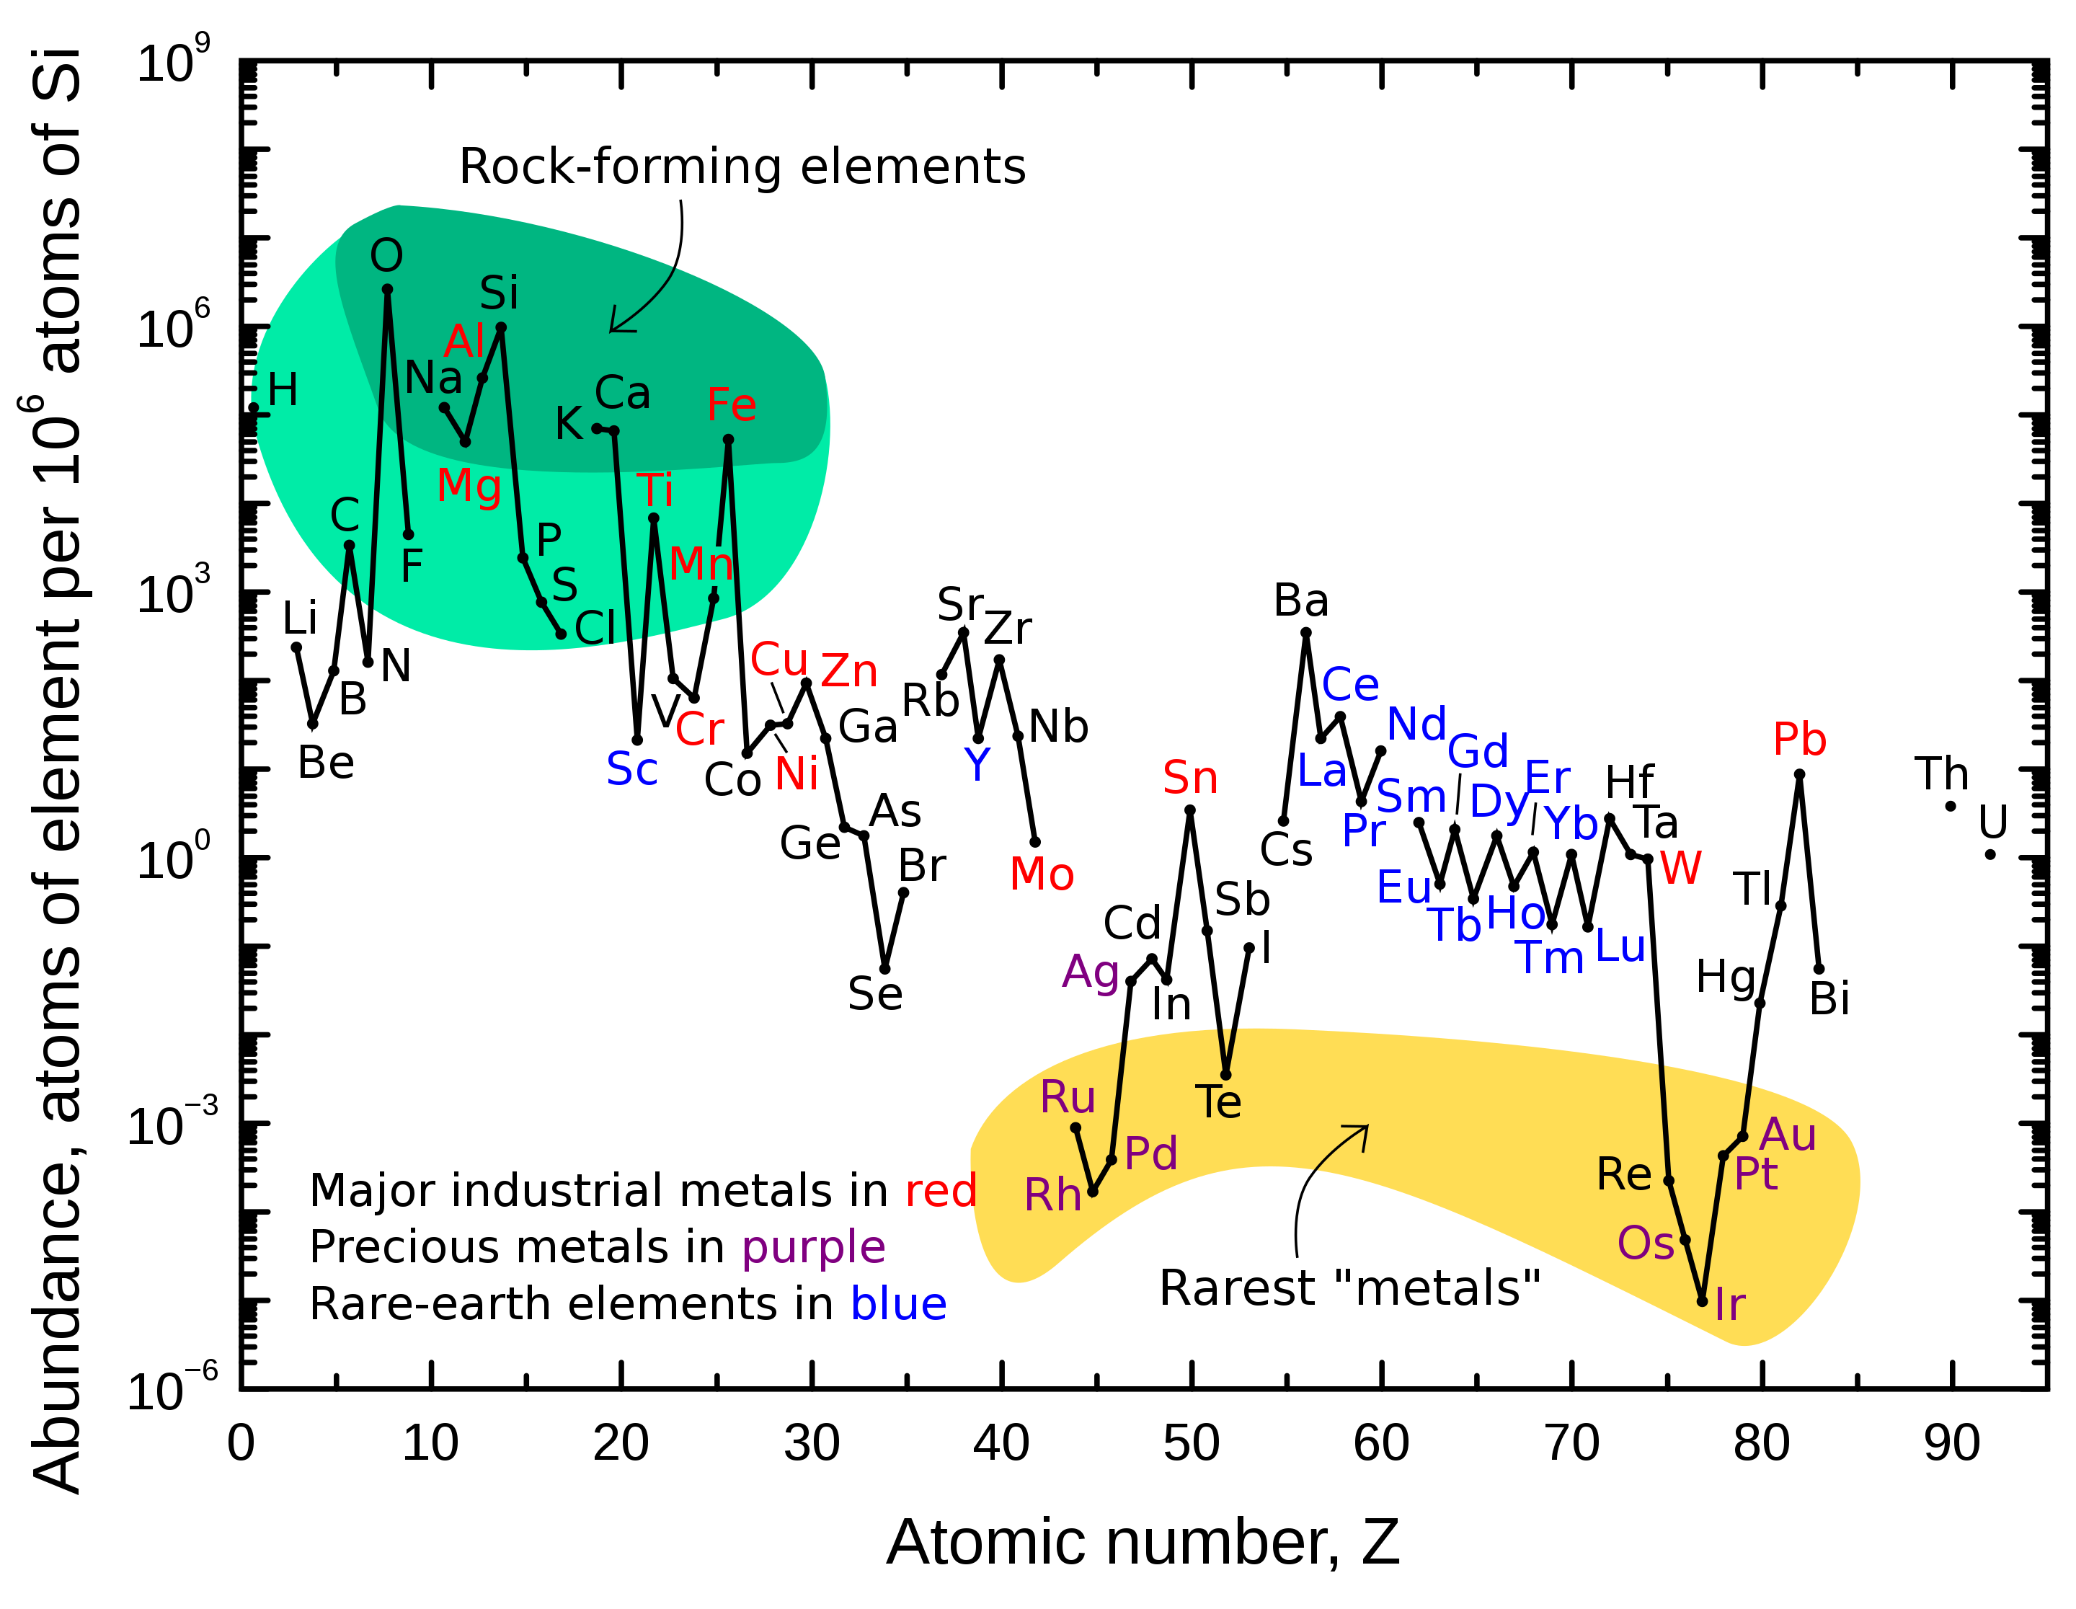
“Rare types are important too”
Rarest inert metals are precious

